Slide 1
Sprint 6 (Covid-19 Edition)
You already know who we are

Slide 2

Document Updates
Business Requirement Document: No major updates!
Management Plan
Updated Gantt Chart
Updated Burndown Chart
Updated Project Tracking Matrix
Updated Sprint Board
Notes:
Big Boi

Slide 3
User stories released this sprint
Completed:
User friendly UI
In progress user stories:
Users should be able to search for food
Users should be able to log in
Users should be able to scan a barcode
Users should get feedback on the food item they scan
Notes:
Big Boi

Slide 4
Api and server
API
OpenFoodFacts
Server
Firebase
ODM Library
Firebase Firestore
Notes:
Hassan

Slide 5
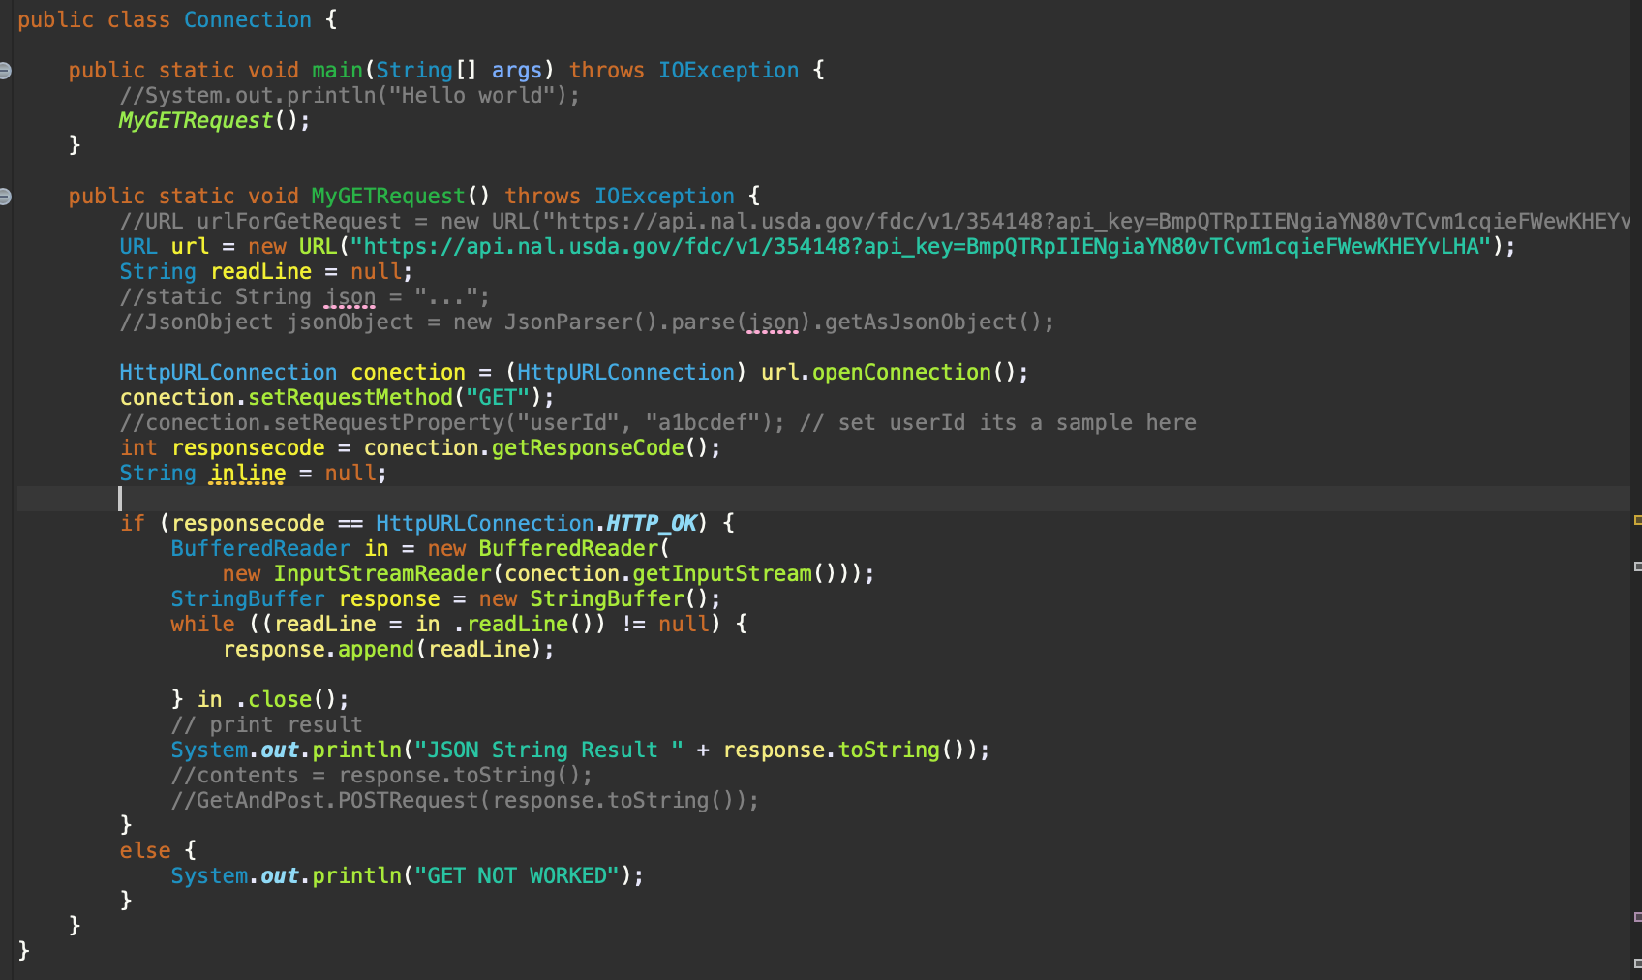
API Call
Notes:
Hassan

Slide 6
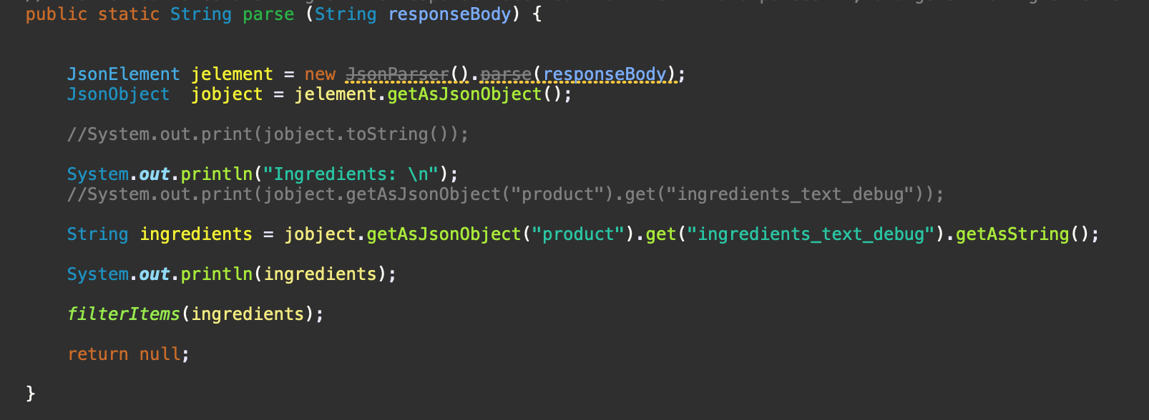
Parsing json
Notes:
Hassan

Slide 7
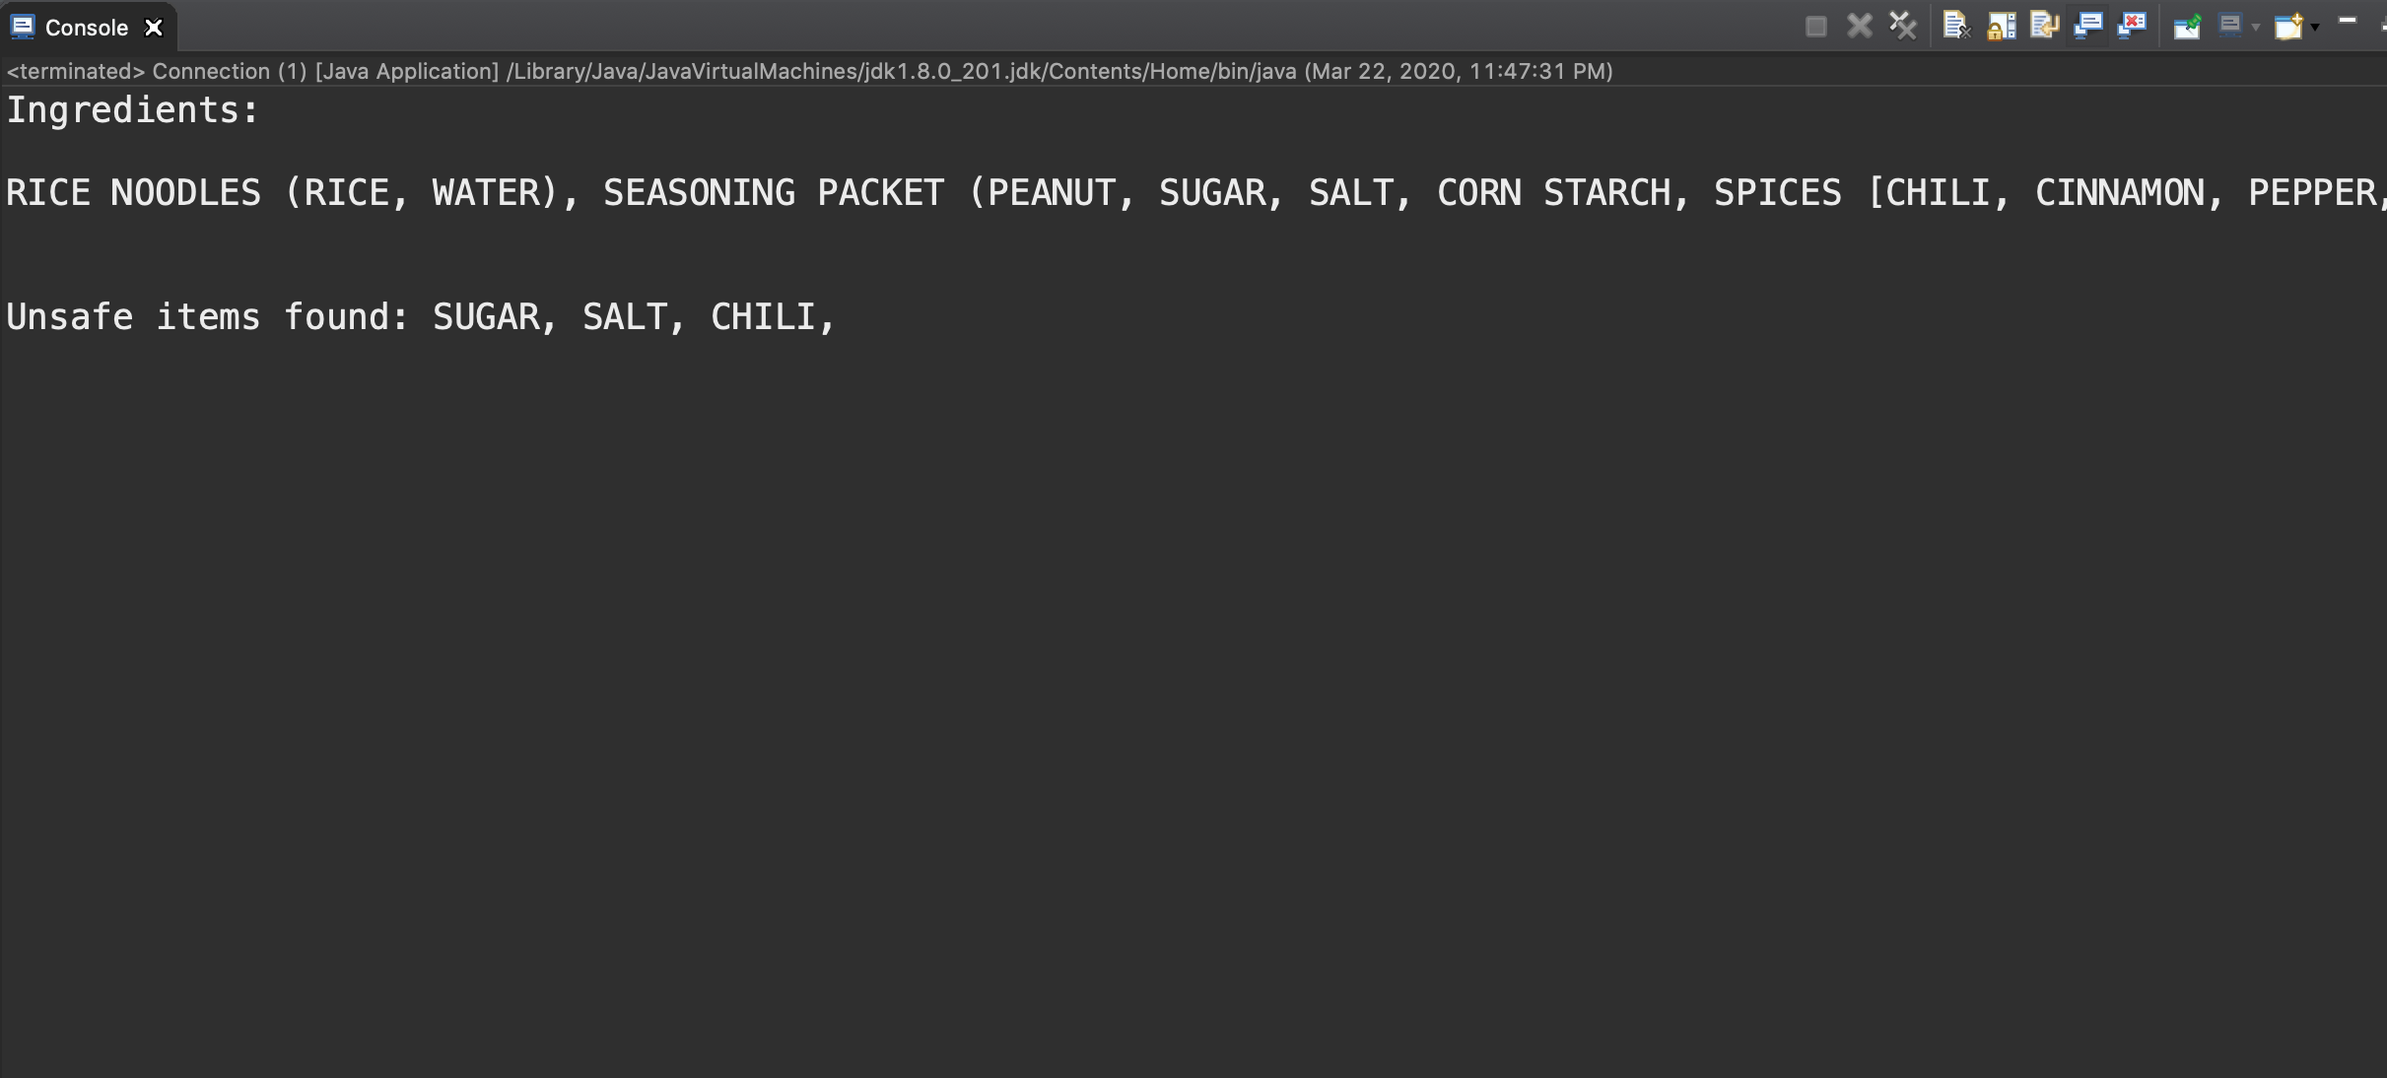
Filtering the unsafe items
Notes:
Hassan

Slide 8

UI Walkthrough
Notes:
josue

Slide 9
What’s next for UI
Finish settings feature
Finish profile feature
Integrate the scanner
Set up async methods for api calls
Download Healthy Belly here :) :https://drive.google.com/drive/folders/1gZDSGnTG11icvvA5vR-NIMlpMWycnQZ1?usp=sharing
Notes:
josue

Slide 10
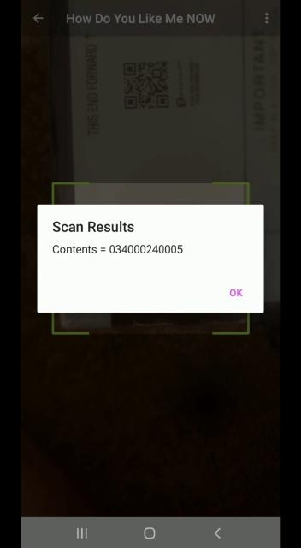
Scanner Video Demo
Notes:
Big boi

Slide 11
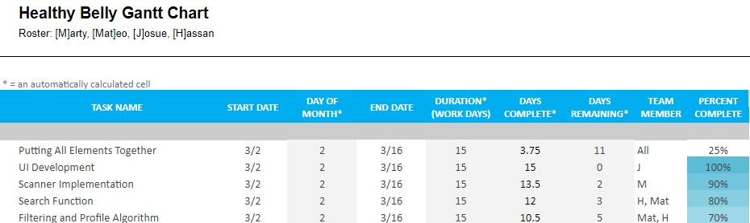
Gantt Chart
Notes:
MATEO

Slide 12
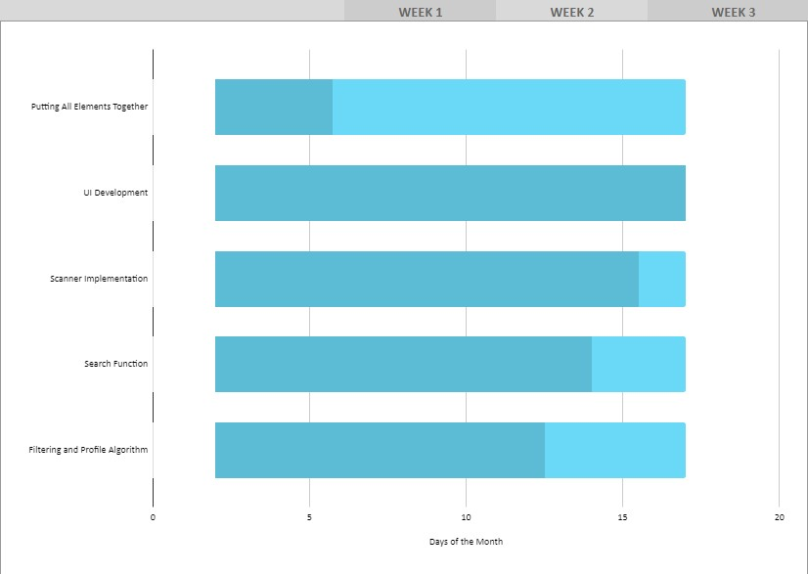
Gantt Chart
Notes:
MATEO

Slide 13
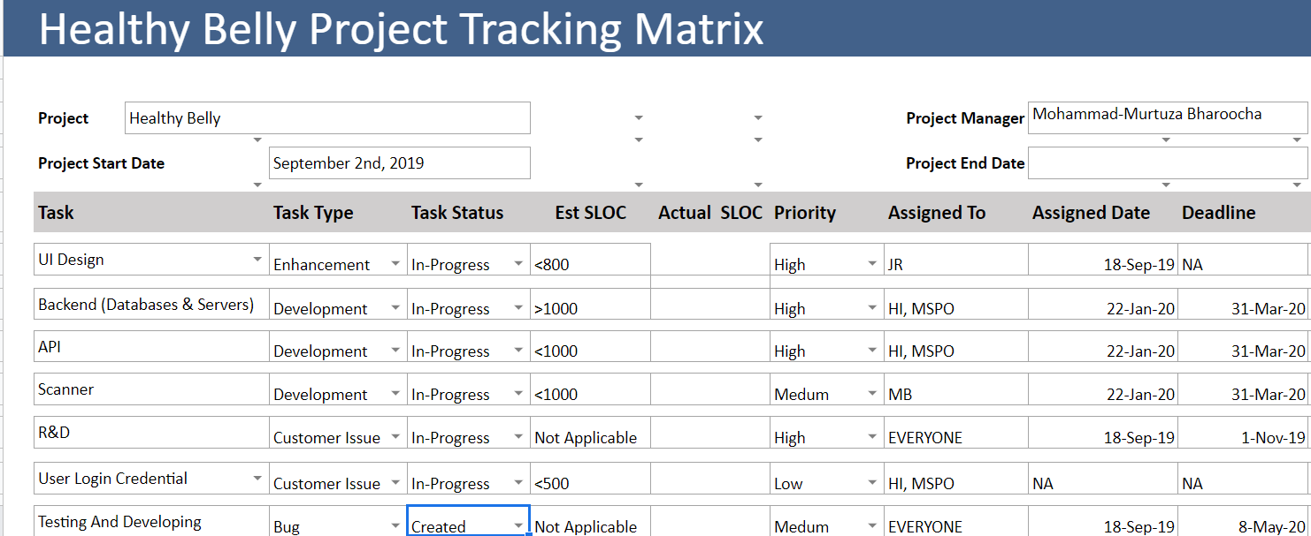
Project Tracking Matrix
Notes:
MATEO

Slide 14
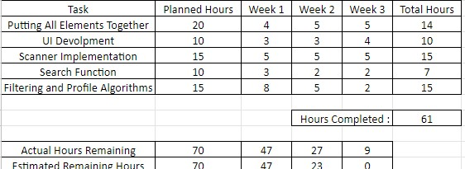
Burndown Chart
Notes:
Mateo

Slide 15
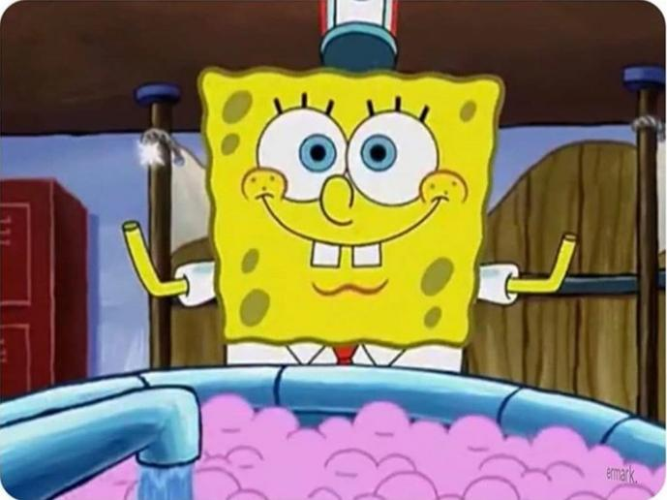
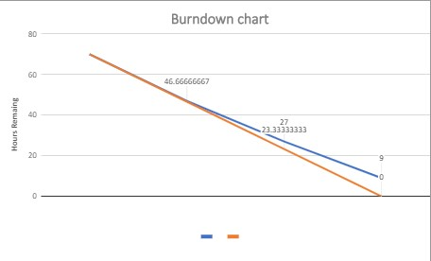
Burndown Chart
Notes:
Mateo

Slide 16
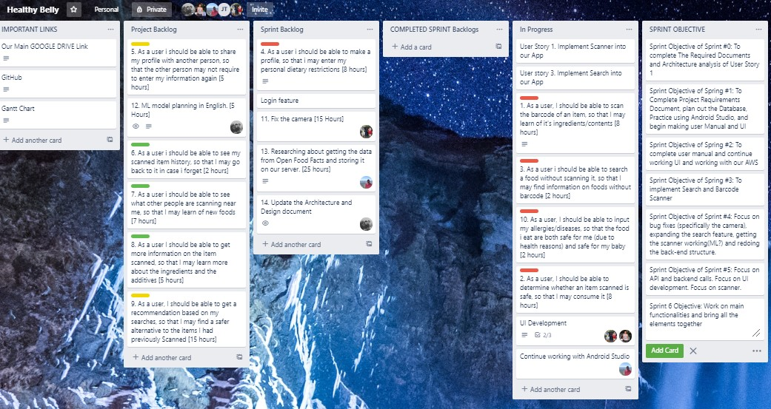
Sprint Board
Notes:
MATEO

Slide 17
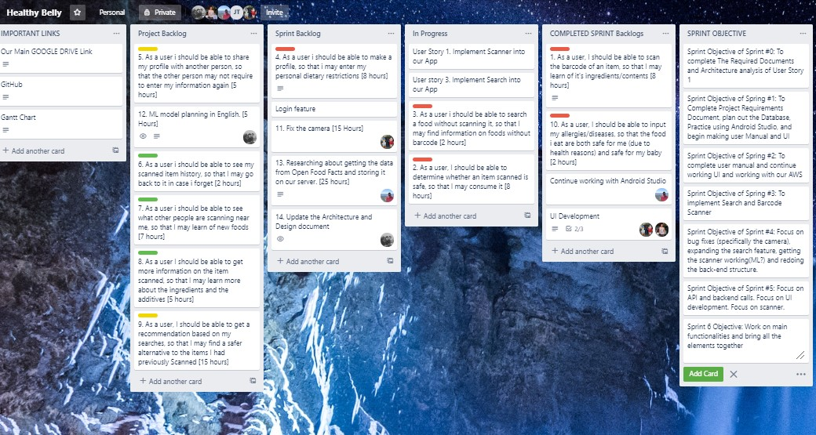
Sprint Board
Notes:
MATEO

Slide 18
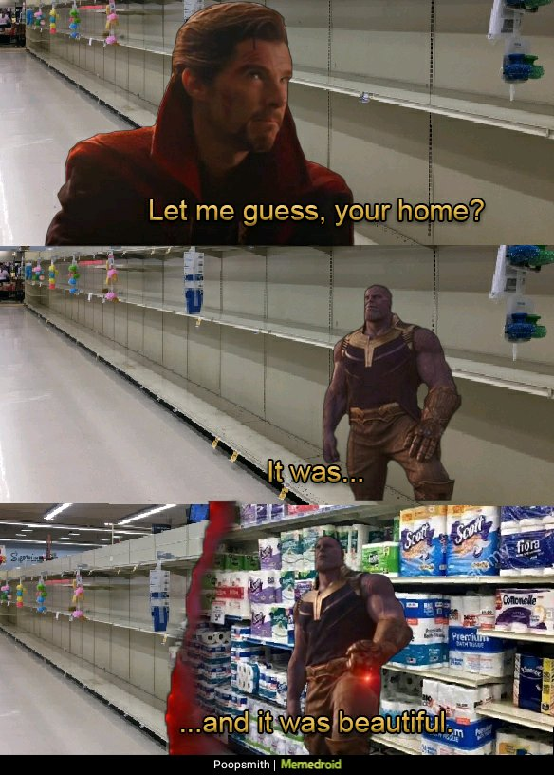
retrospective
Due to the global crises of Covid -19, we were unable to meet and work together. For the scanner and API call to work together, we need to be physically present in order to work.
This sprint, we mostly learned how badly we, as a nation, are to responding to global crises
But you know whats really good
At responding.. Healthy Belly api
calls
Also learned how to wash hands
Notes:
Big boii

Slide 19
Surprise Time?

Slide 20
Thank you for your time! :*
Any Questions???

